Slide 1
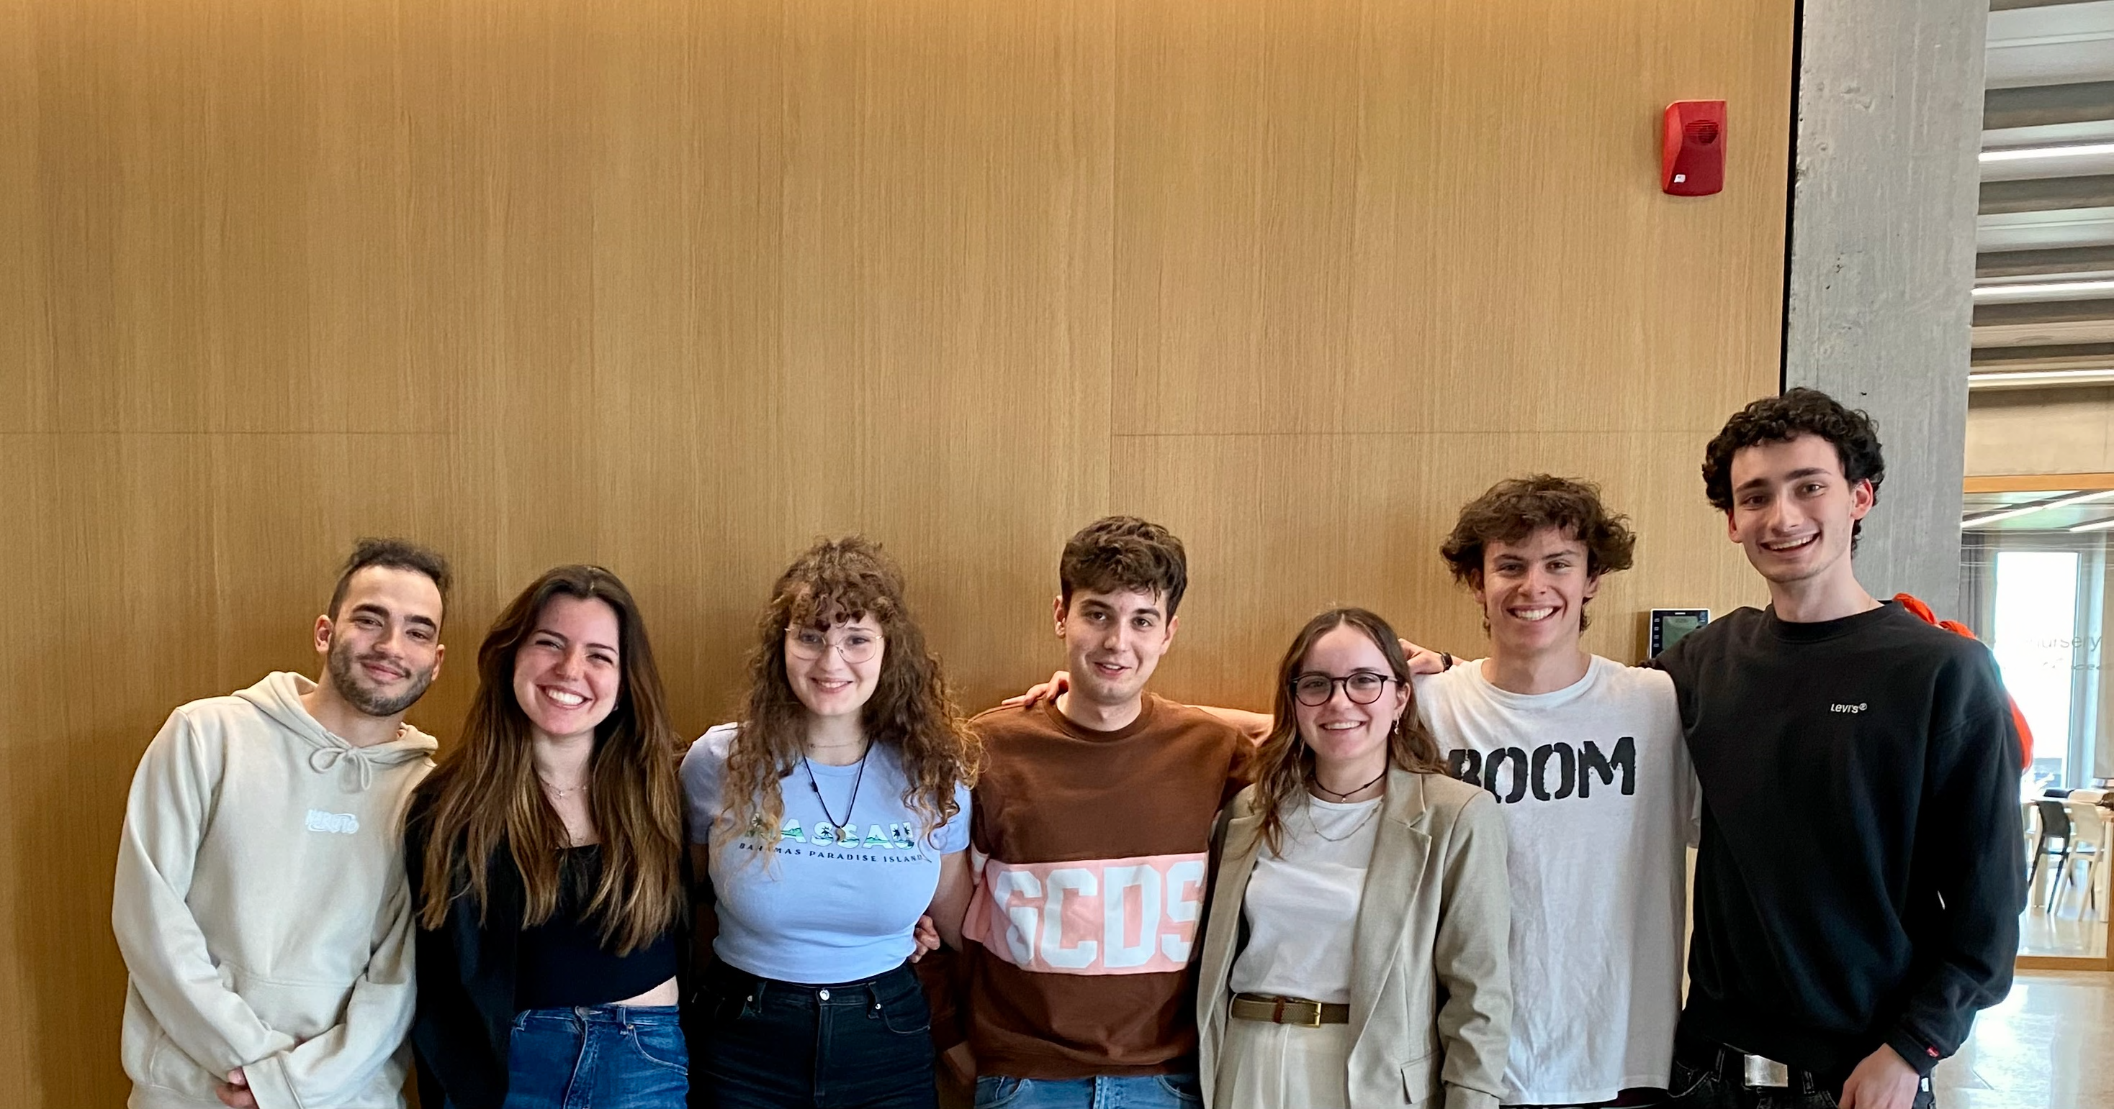
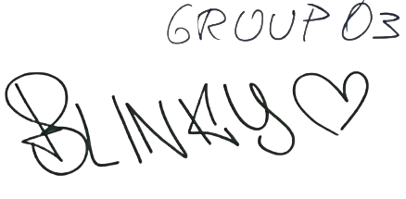
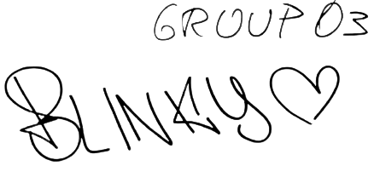
Francesc Sacco
Lamberto Ragnolini
Alessandro Lucchesi
Giulia De Marco
Giorgia Lillo
Sergio Boffi
Giulia Ambiveri

Slide 2

M&L App

Slide 3
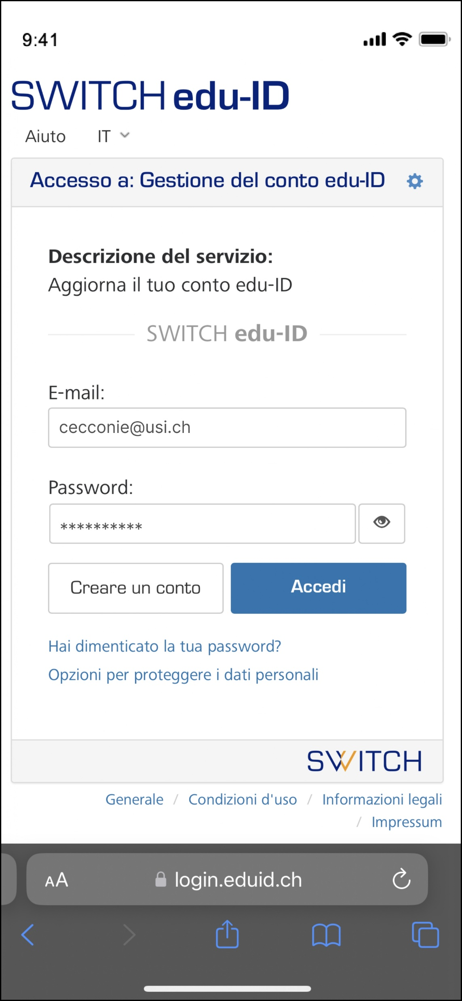
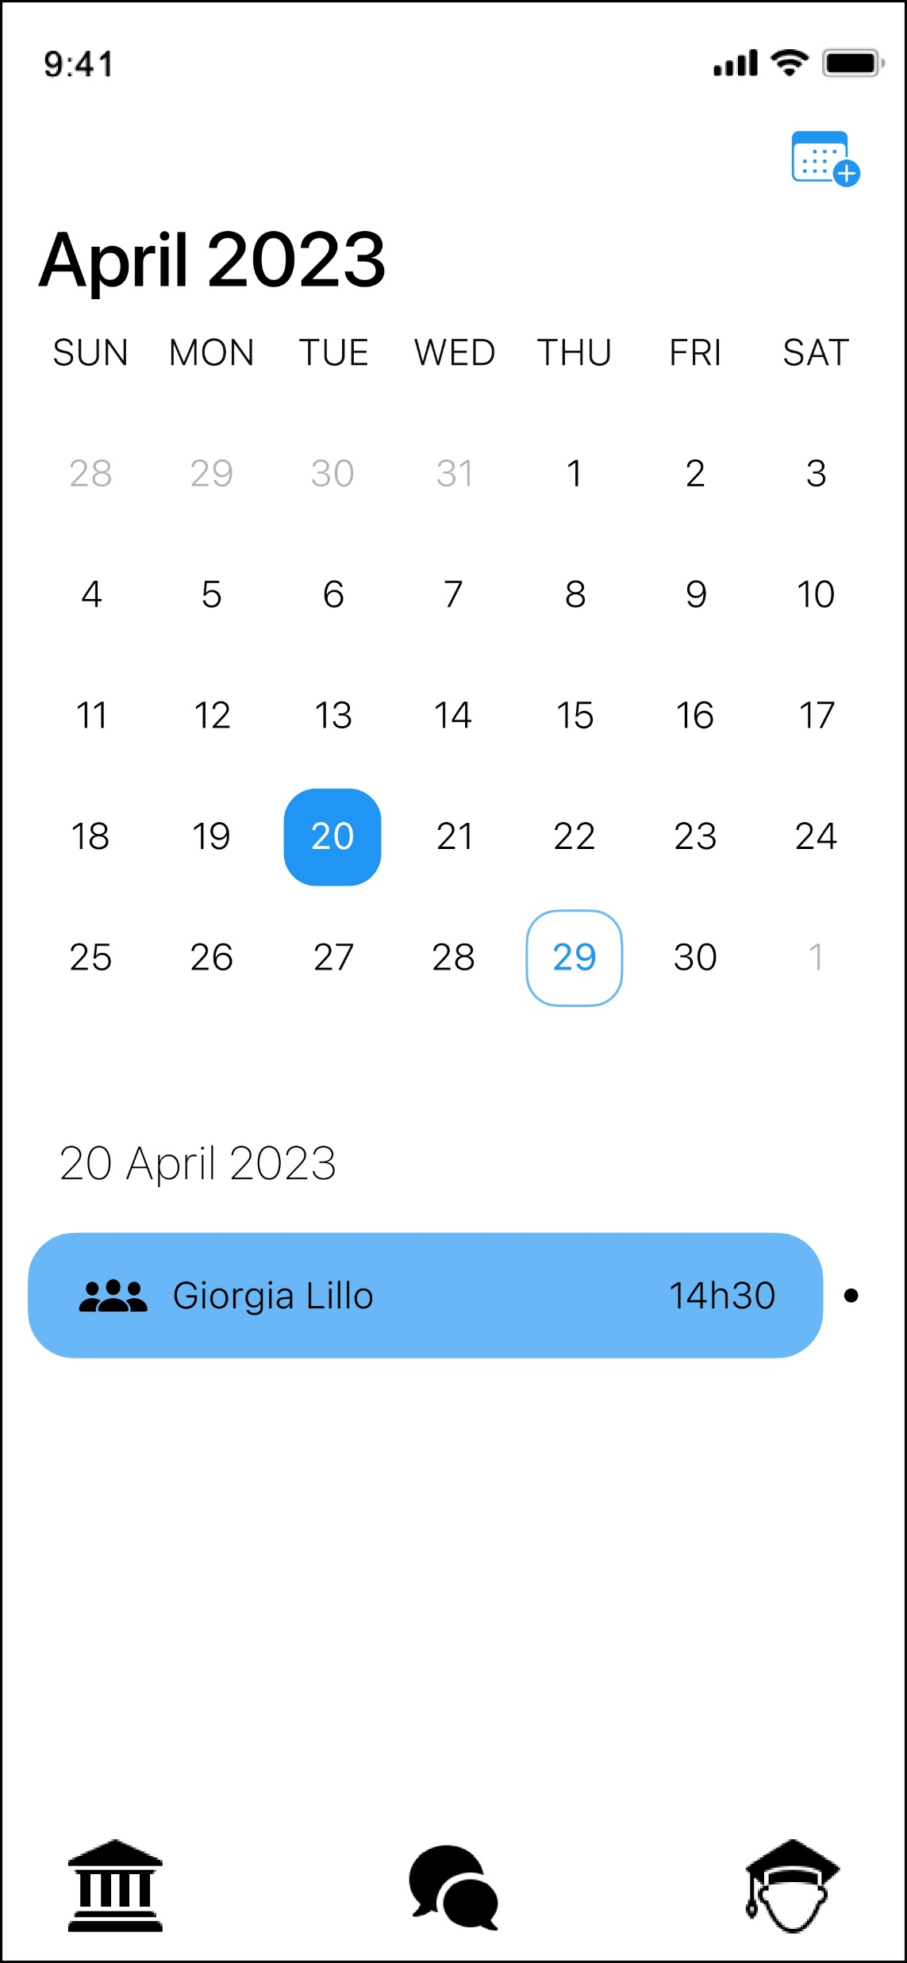
ACCESS WITH YOUR USI CREDENTIALS!

Slide 4
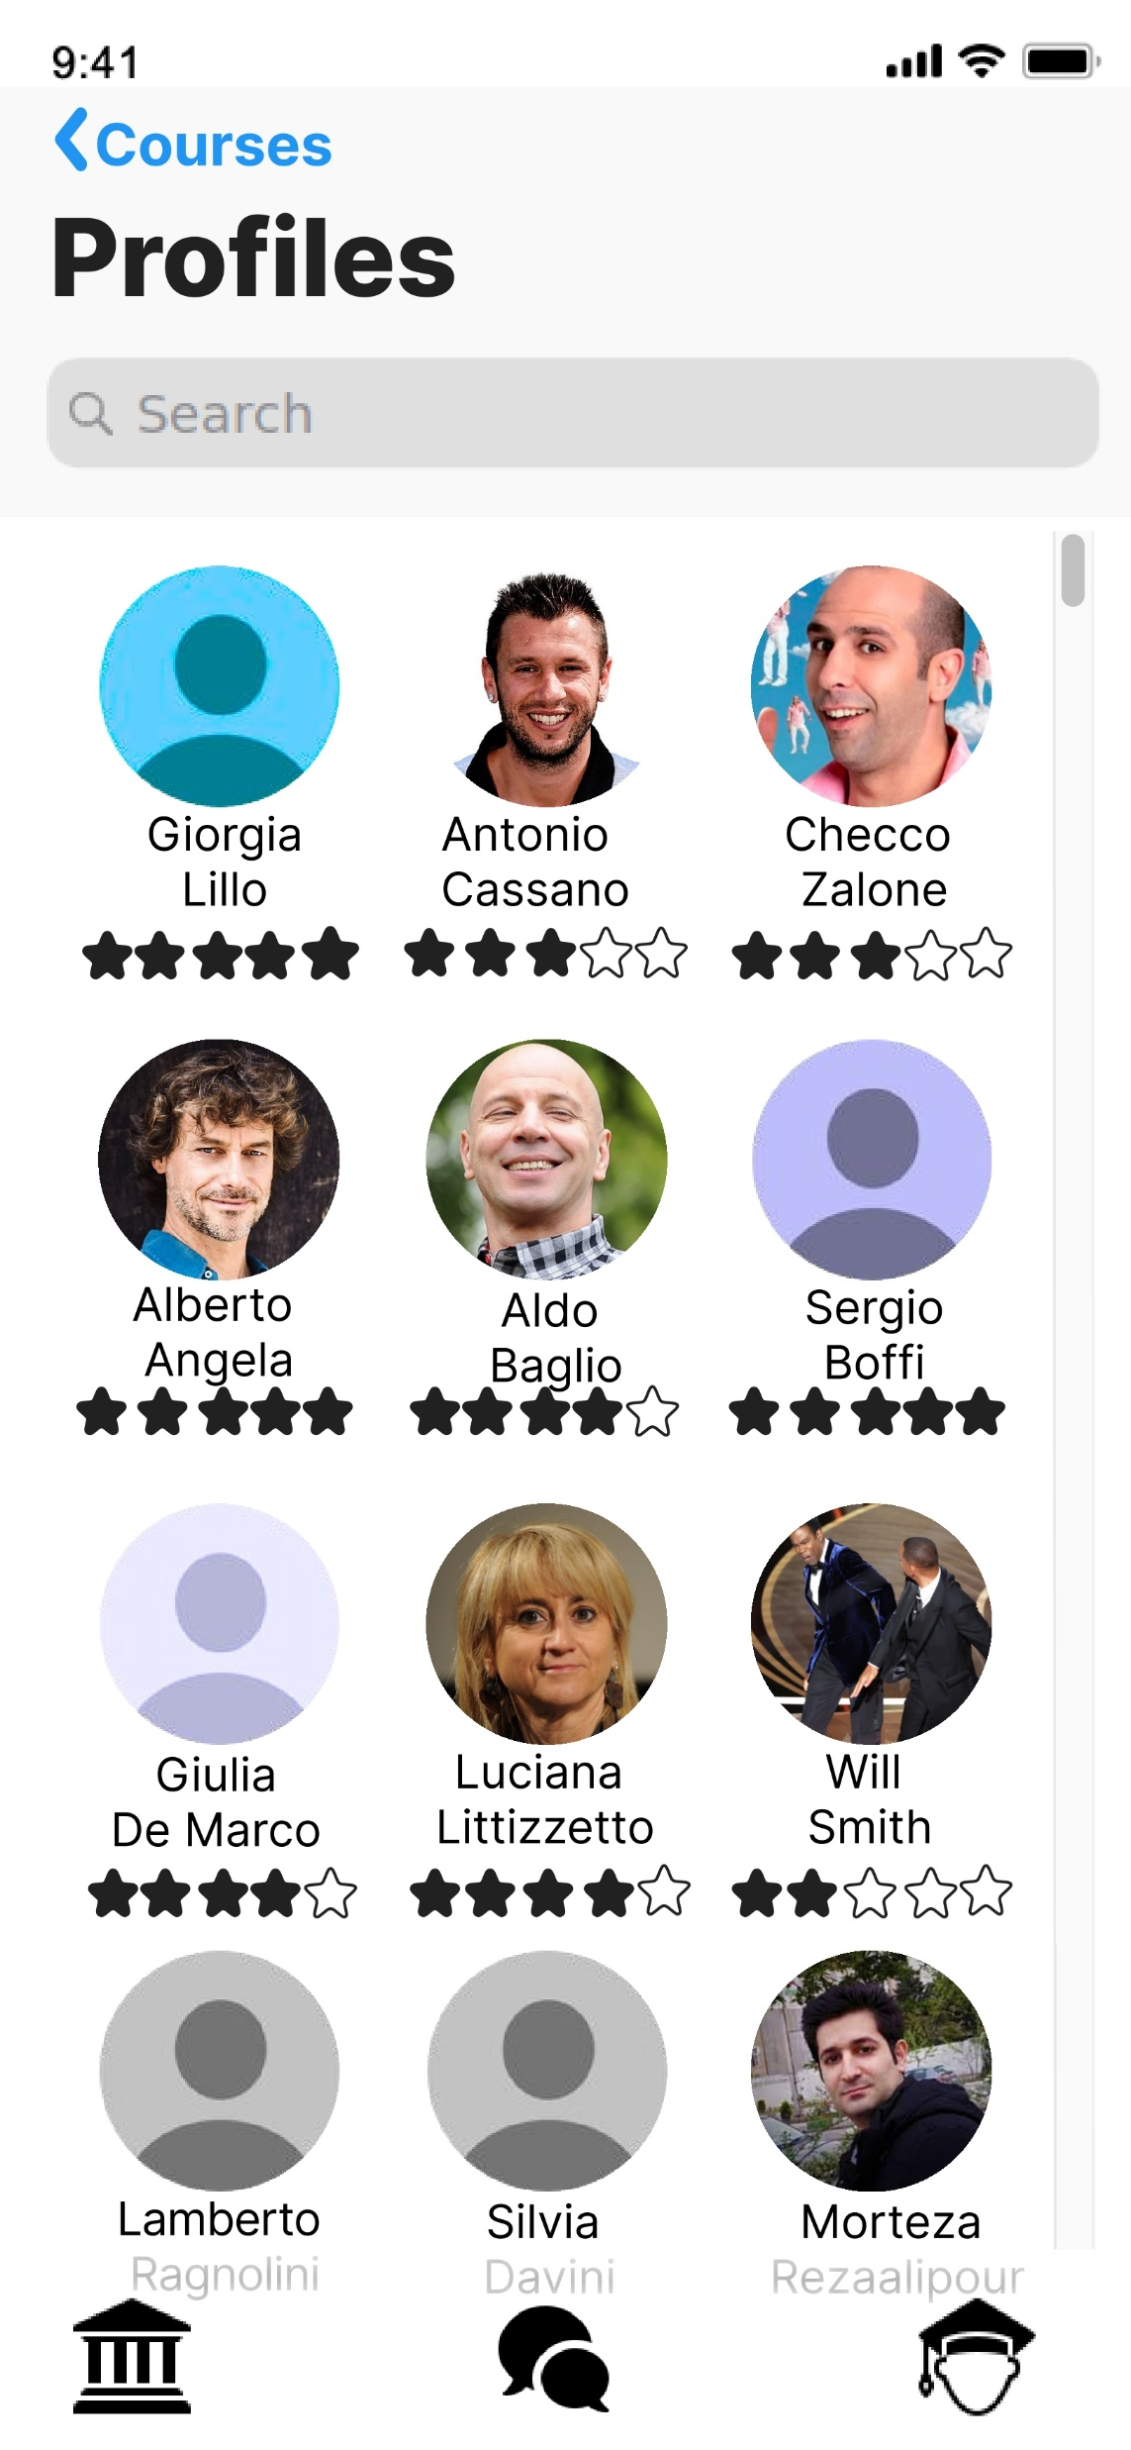
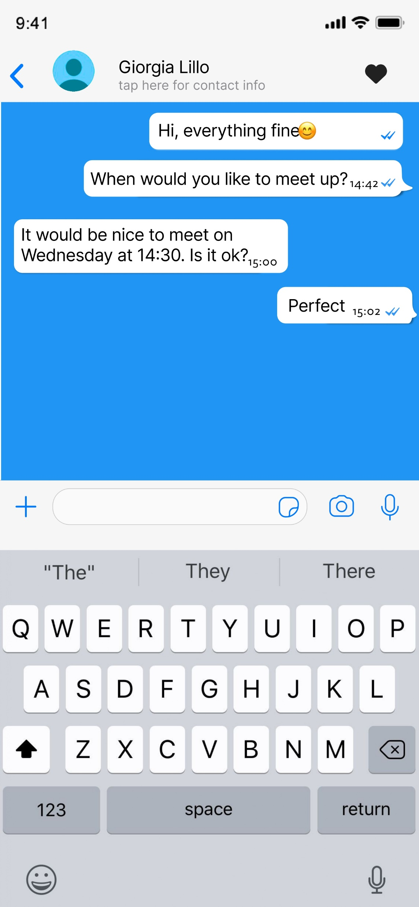
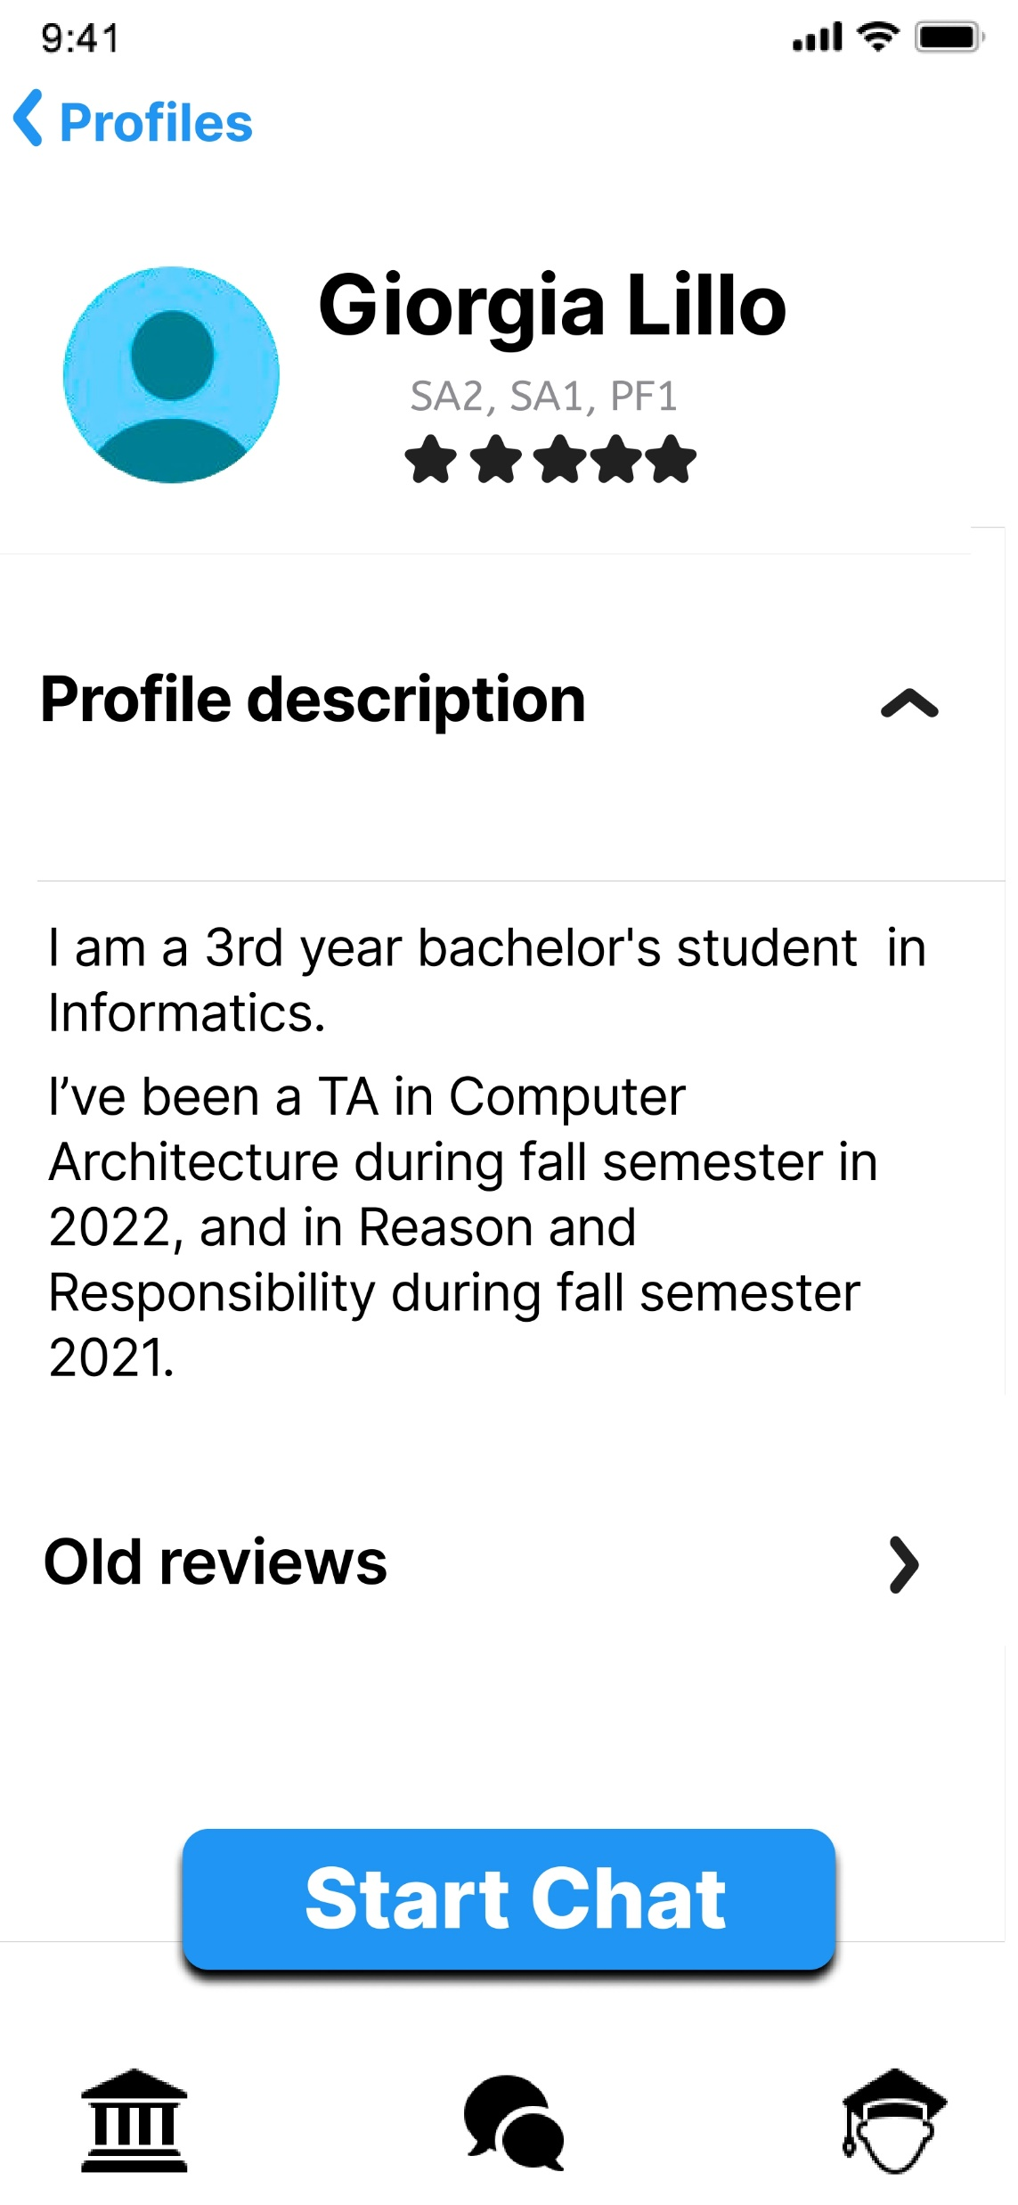
REACH OUT TO YOUR PREFERRED GIVER!

Slide 5
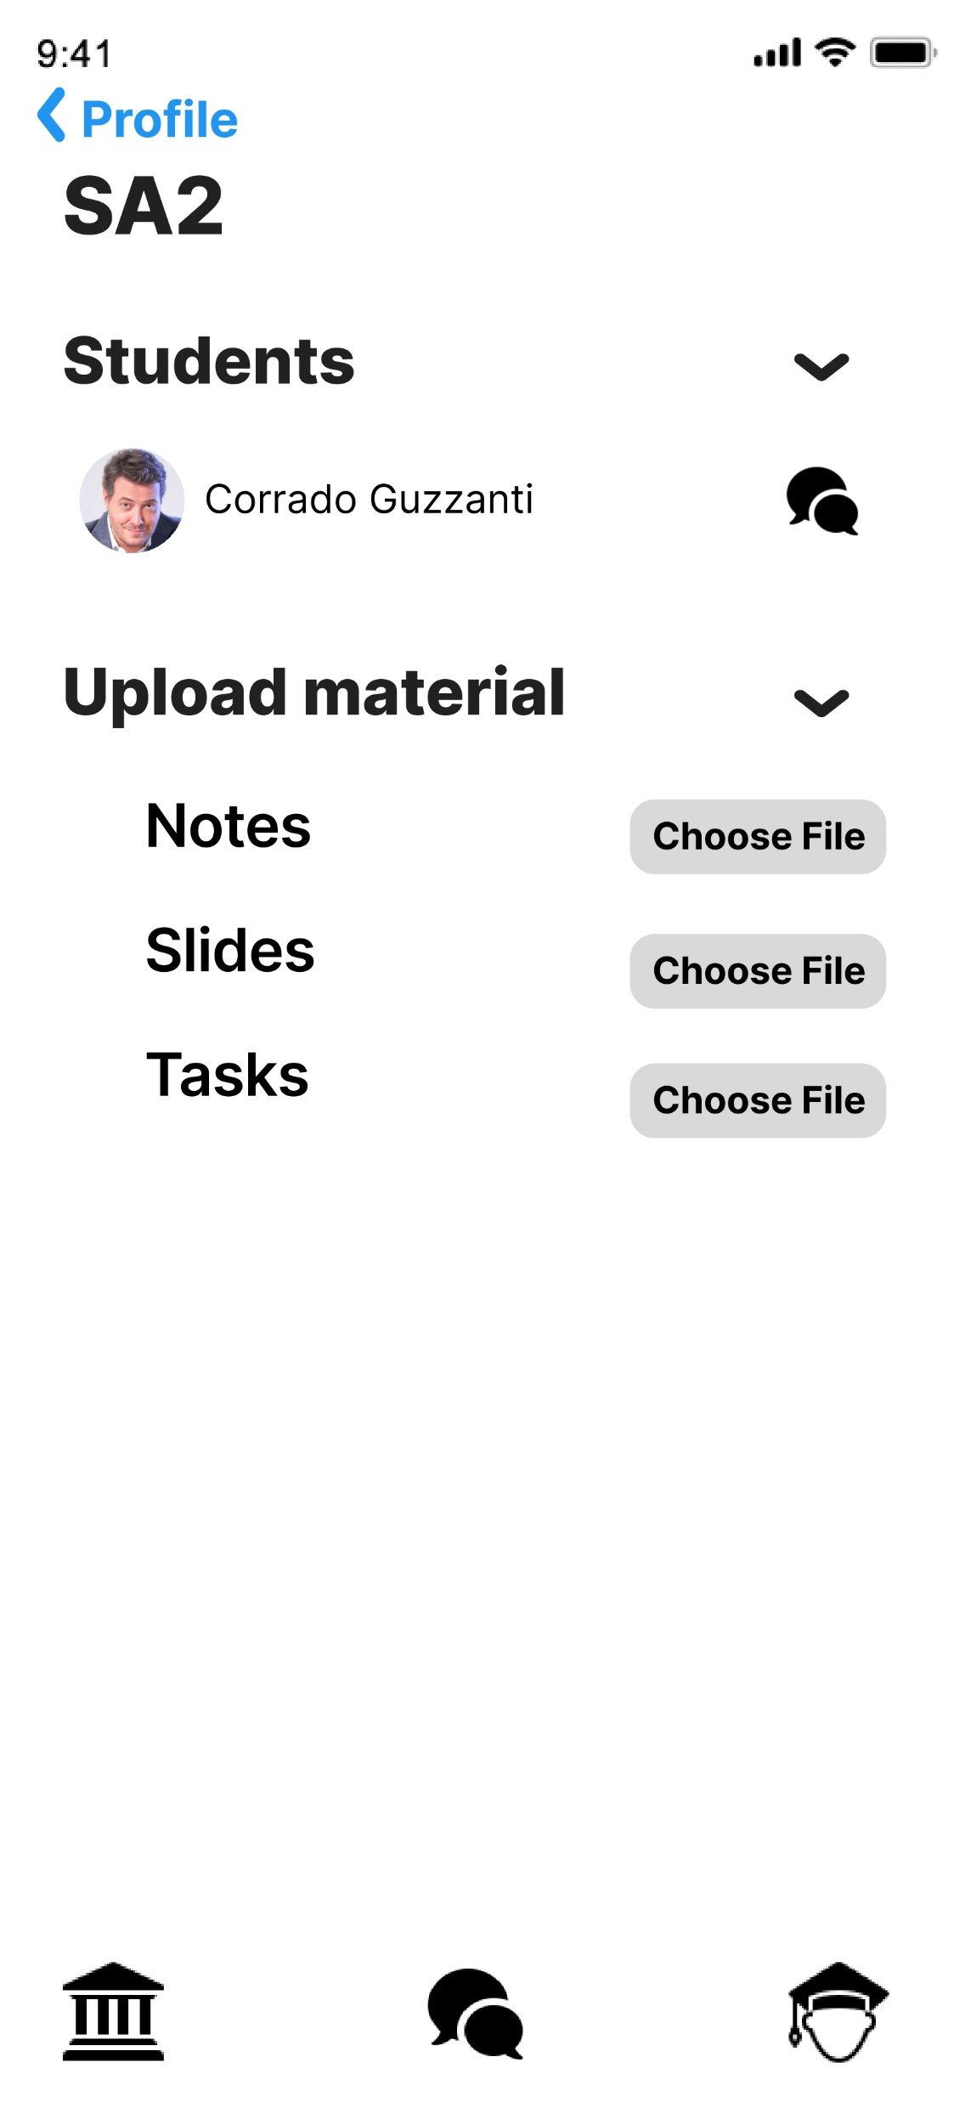
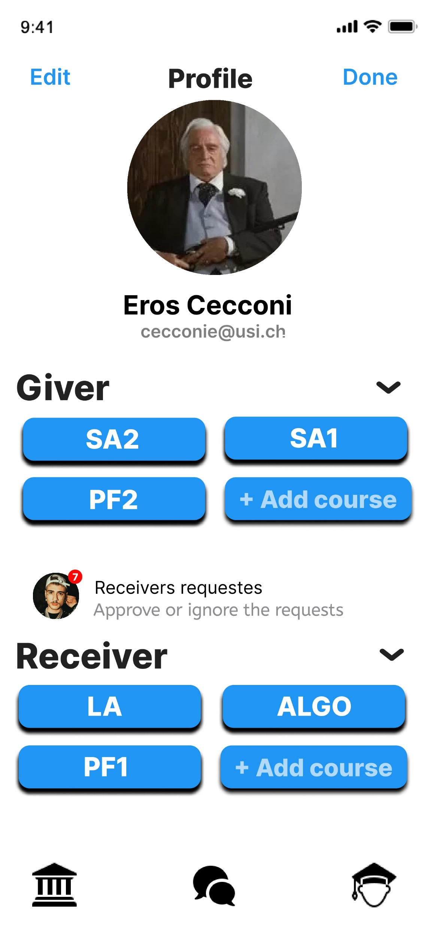
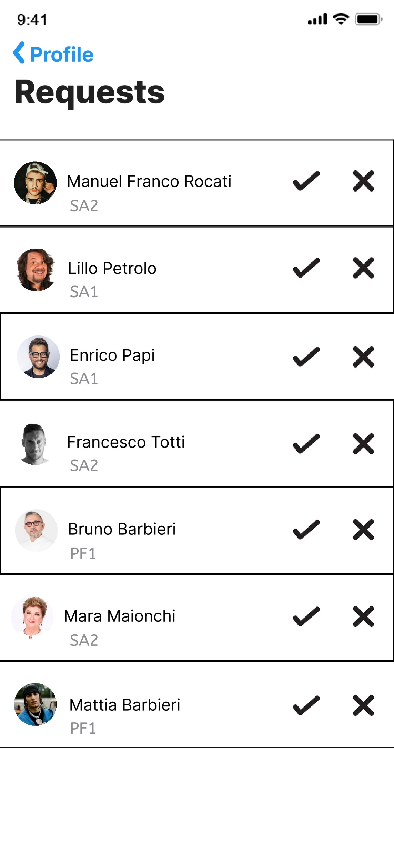
CHECK OUT YOUR PROFILE AND WHATS GOING ON

Slide 6
INSIGHTS GAINED
INTERVIEWS:
9 INTERVIEWS
NO MAJOR DESIGN ISSUES WERE RAISED
FIND OUT IF THE STUDENTS NEEDED ASSISTANCE WITH THEIR STUDIES AND HOW
→ they preferred to be supported
”GIVER” CONCEPT WAS DISCUSSED.
→ whether students were willing to provide free notes and lessons
FUN AND EFFECTIVE EXPERIENCE TO FIND USERS’ NEEDS.
USABILITY TESTS:
14 TESTS.
SUS AVERAGE OF 90
MAIN PROBLEM → BAD CONSTRUCTION OF TASKS
IMPOTANT ISSUE → ABSENCE OF A REAL HOME SECTION
NO PROBLEMS WITH THE CONNECTIONS!....SURPRISINGLY
THE INTERVIEWEES ALSO TOLD US THAT OUR APP IS VERY INTUITIVE AND THE DESIGN IS VERY NICE
TESTS OF THE POSSIBLE USERS HELPED US TO IMPROVE OUR APP :)

Slide 7


Slide 8

THANK YOU FOR YOUR ATTENTION! IF YOU GOT ANY QUESTIONS DON’T HESITATE TO ASK :)

